Slide 1
AI Parts Recommendation
Recommendations as a product.
Kim Horn
Version 2.5
5 Sept 2024

Slide 2
Agenda
Association Rules
History
Example
Combinations
Solutions
Apriori
FPGrowth
Exploration
POC – Rules and Knowledge Graphs
Summary
Appendix

Slide 3
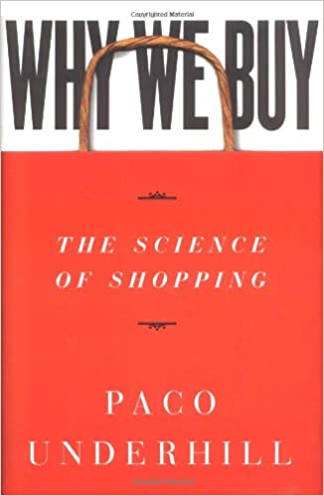
Association Rules
Association rules are an unsupervised machine learning* method whose aim is to discover hidden patterns in large amounts of data, in the form of rules that express interesting associations between items.
The approach is used widely, in many fields, including recommendation engines, retail analysis of transactions, market basket analysis, clickstream analysis across web pages, inventory optimisation, fraud detection, high risk customer identification, medical diagnosis, protein sequencing, weather forecasting and email filtering.
Used by: Netflix, Amazon , eBay, Wal-Mart, Flipkart, Instacart, etc, etc
*Machine learning is a subset of AI

Slide 4
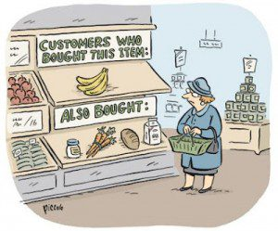
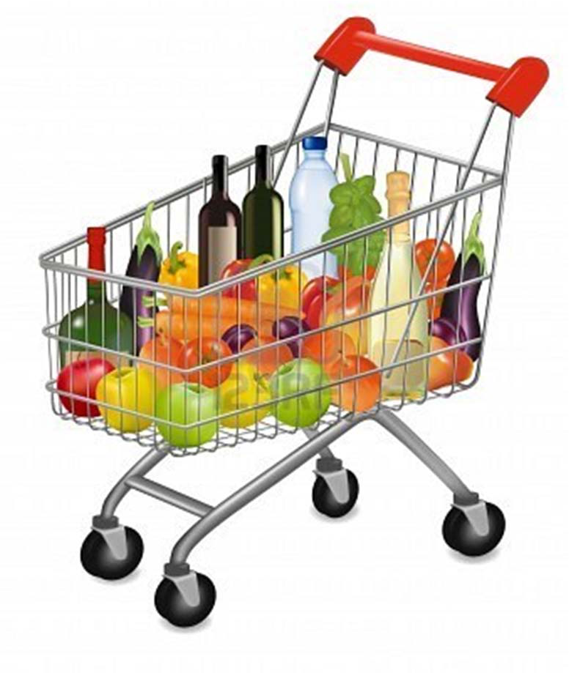
History (Folklore)
Market Basket Analysis: given a database of customer transactions, where each transaction is a set of items, the goal is to find groups of items which are frequently purchased together.
Probably the biggest most researched and applied AI/Machine Learning (Data Mining) approach in the world today !!
In 1992, Thomas Blischok, manager of a retail consulting group at Teradata prepared an analysis of 1.2 million market baskets from about 25 Osco Drug stores. Database queries were developed to identify affinities. The analysis "did discover that between 5:00 and 7:00 p.m. that consumers bought beer and diapers".
Seems new fathers on a late-night run to get diapers also bought beer.
Notes:
Content-based filtering. It relies on similarities between features of the items. It recommends items to a customer based on previously rated highest items by the same customer. List of features about these items needs to be generated.
Collaborative Filtering, on the other hand, doesn’t need anything else except users’ historical preference on a set of items. Because it’s based on historical data, the core assumption here is that the users who have agreed in the past tend to also agree in the future. In terms of user preference, it usually expressed by two categories. Explicit Rating, is a rate given by a user to an item on a sliding scale, like 5 stars for Titanic. This is the most direct feedback from users to show how much they like an item. Implicit Rating, suggests users preference indirectly, such as page views, clicks, purchase records, whether or not listen to a music track, and so on. In this article, I will take a close look at collaborative filtering that is a traditional and powerful tool for recommender systems.

Slide 5
Many types of Product Recommenders
Most Popular Items – The Simplest Strategy
The simplest strategy is to just offer the customer whatever is most popular, be that a movie, a book, or an article of clothing.
Note that the most popular item may not be related to what they have already bought, or really want, in market basked scenarios. A popular item can be completely unrelated, or not recommended, in relation to the basket*.
Association or Market Basket Analysis
Association Analysis and Market Basket Analysis looks almost exclusively at content. Types:
Association - customers typically acquire the items or services one at a time (like banking services)
Market Basket - customers potentially buy several things at once, find those things that fit together in the basket, if one or more is not bought then suggest it. The match here is on content in the basket.
Collaborative Filtering
The collaborative filtering method is based on gathering and analyzing data on user’s behavior. This includes the user’s online activities and predicting what they will like based on the similarity with other users. The match here is on similar users.
* following example will show this

Slide 6
Many types of Product Recommenders
Content-Based Filtering
Content-based filtering methods are based on the description of a product and a profile of the user’s preferred choices. Products are described using keywords, and a user profile is built to express the kind of item this user likes.
Hybrid Recommendation Systems
In hybrid recommendation systems, products are recommended using both content-based and collaborative filtering simultaneously to suggest a broader range of products to customers.
Rule or Knowledge Based Recommenders.
Either by mining, commonsense, causality or expert knowledge create association rules or patterns of items that should be bought together, e.g. strawberries and cream, gin and tonic.
These recommenders could be goal based, for example, the person is likely to be making tandoori chicken, find the recipe and suggest items left out. Today LLMs can help with this kind of knowledge.

Slide 7
Association Rules
An association rule has two parts: an antecedent (if) and a consequent (then), reversing is a different rule.
Likely Unlikely Likely Unlikely
If Diapers If Beer If Engine If Oil
Then Beer Then Diapers Then Oil Then Engine
What is ‘likely’ - Many Metrics:
Support is an indication of how frequently the items appear in the data.
Confidence (Strength) indicates the number of times the if-then statements are found true.
Lift (Interest) indicates the strength of a rule over the random co-occurrence of the antecedent and the consequent, given their individual support. It provides information about the improvement, the increase in probability of the consequent given the antecedent, to give more ‘interesting’ rules. Values:
> 1 is a positive correlation, bigger means stronger.
< 1 is a negative correlation, smaller means more negative.
= 1 no correlation.
Notes:
If/Then are not switchable.
If buy Engine then oil

Slide 8
Types Of Rules
Interesting Rules
contain high‐quality, interesting, actionable information
These are assets that are themselves a product.
Trivial Rules (and redundant rules)
information already well‐known by those familiar with the domain
Inexplicable Rules
no explanation and do not suggest action
Generic Vs Specific Rules (Knowledge of a hierarchy/ontology)
If Baby Product then Beverage
If Diapers then Beer
If Pampers Baby-Dry Then Corona Extra
How do you measure ‘likelihood’ and ‘interesting’ ?
Its both Objective and Subjective - Many Methods and Metrics, e.g. Lift, see Appendix
Notes:
Are further metrics and rule approaches that cover ‘Interesting’, easiest is human review.

Slide 9
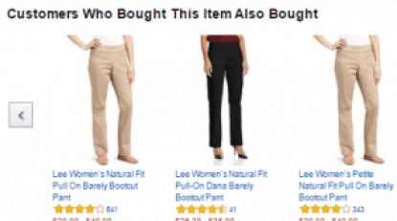
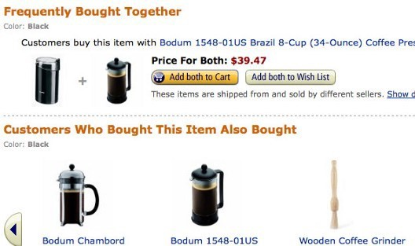
Examples - well known ‘Interesting’ Associations
Wal‐Mart customers who purchase Barbie dolls have a 60% likelihood of also purchasing one of three types of candy bars [Forbes, Sept 8, 1997]. They sell a barbie doll every 20 seconds.
Customers who purchase maintenance agreements are very likely to purchase large appliances (Linoff and Berry experience)
When a new hardware store opens, one of the most commonly sold items is toilet bowl cleaners (Linoff and Berry experience)

Slide 10
Simple Example

Slide 11
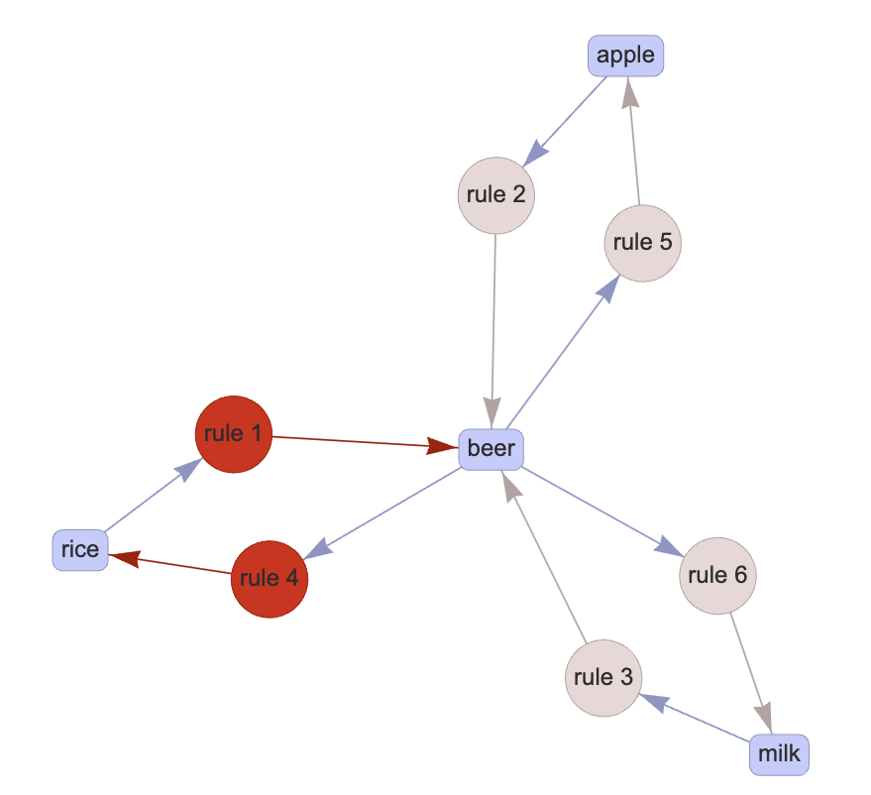
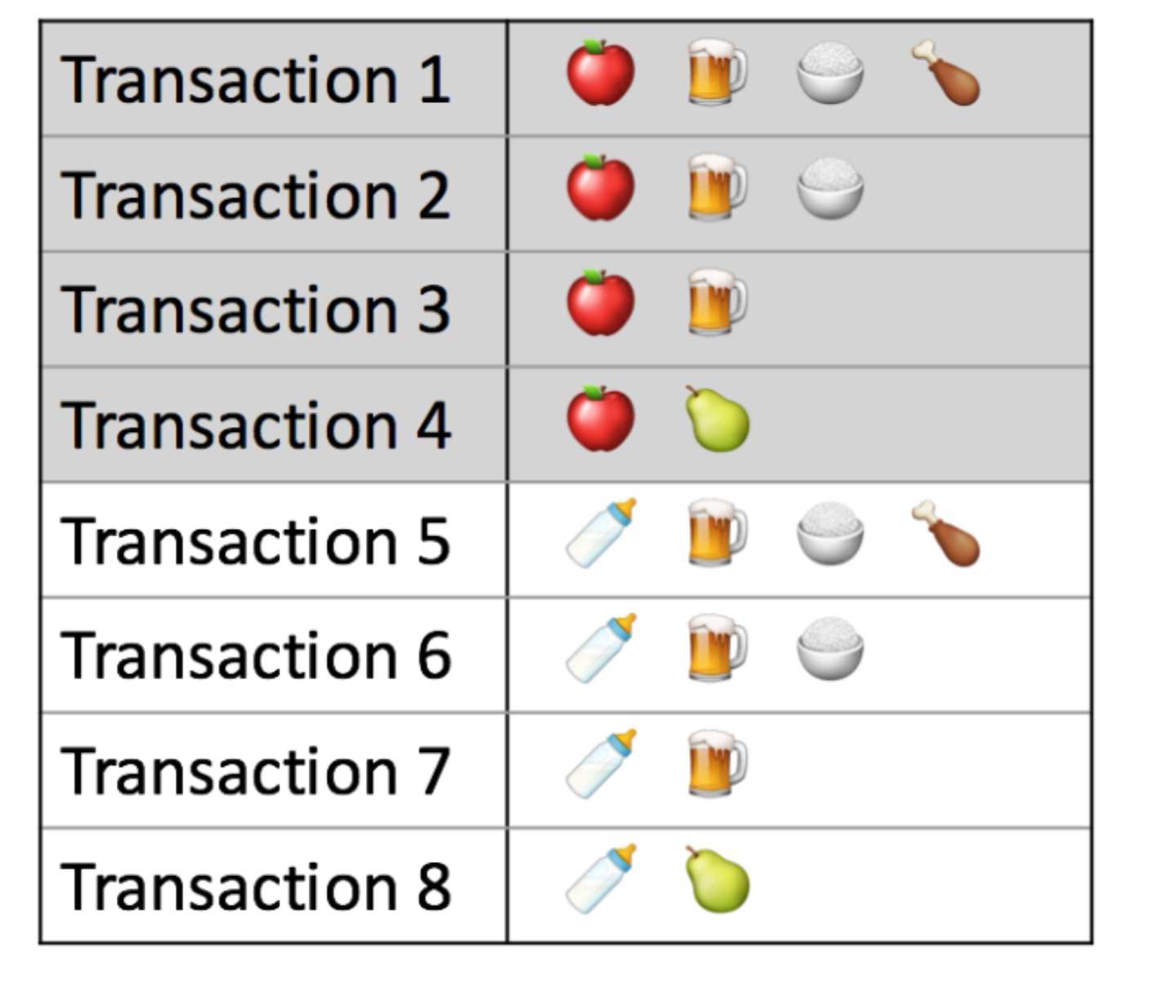
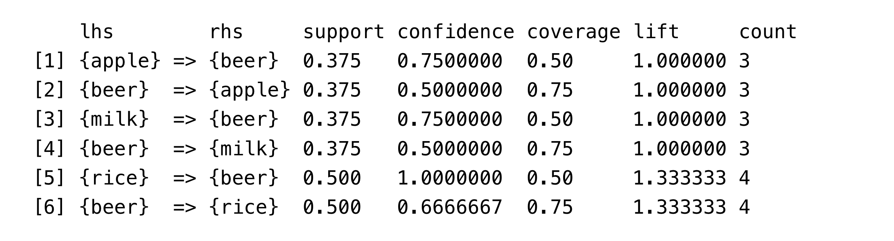
Simple Example – From Transactions to Rules
A set of Transactions, buying Apples, Beer, Rice, Meat and Milk:

Slide 12
Tricky Example

Slide 13
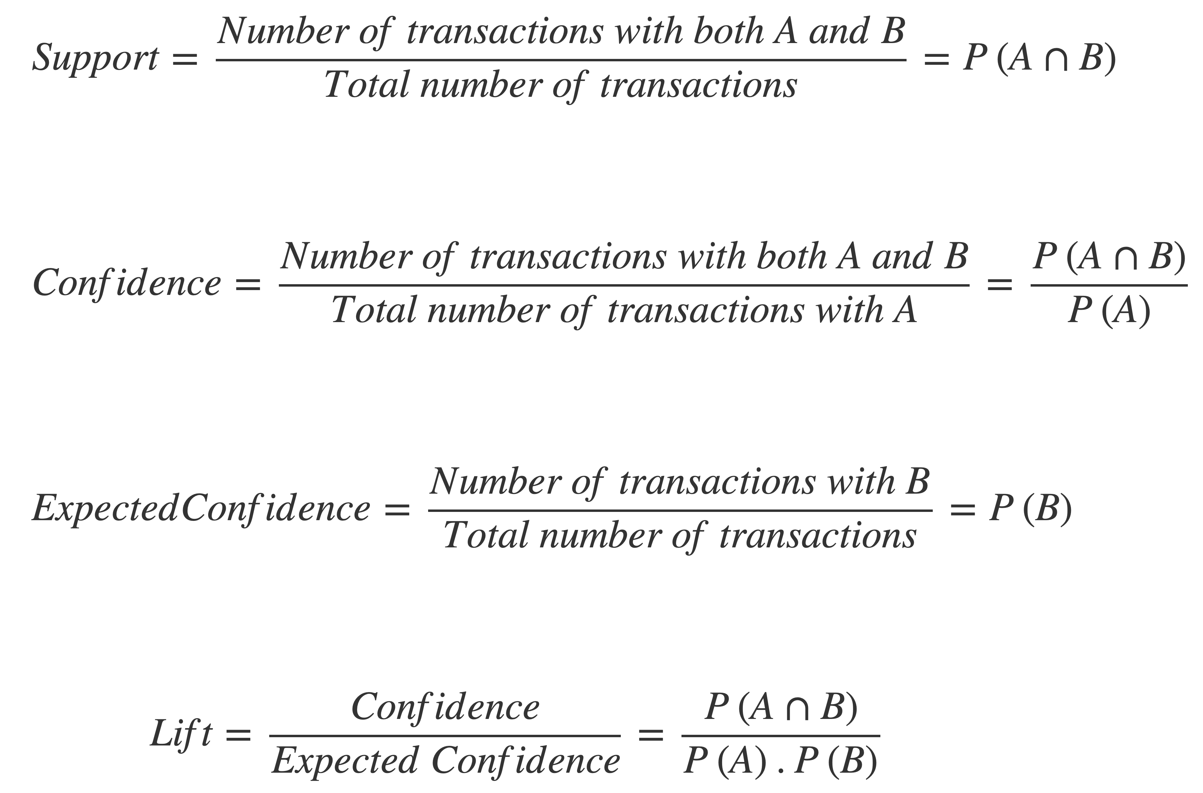
Example – Lets look at Confidence as a Metric
14 Orders with Part A. Of these:
10 have Part B
4 have Part C
In the above, we may have two rules:
Rule 1: Part A ➔ Part B
Rule 2: Part A ➔ Part C
Confidence:
Rule 1: 10/14 = 71% → Looks Good ( Most of the orders with A have B ) !
Rule 2: 4/14= 28%
Intuitively, confidence seems like a good metric

Slide 14
Now Let’s Look at the Other Data and Information
Other Data
70 orders had just Part B, or with other parts
3 orders just had Part C
100 orders in total (other parts, make up the total, D, E, etc)
Probability of Part B = (10+70)/100 = 0.8
Probability of Part C = (3+4)/100 = 0.07
Rule 1: Part A ➔ Part B
Rule 2: Part A ➔ Part C
= 80% - Actual was 71%. A Reduction !
= 7% - Actual was 28%. An Improvement !

Slide 15
Now Let’s Look at the Other Data and Information
Other Data
70 orders had just Part B, or with other parts
3 orders just had Part C
100 orders in total (other parts, make up the total, D, E, etc)
Rule 1: Part A ➔ Part B
Rule 2: Part A ➔ Part C
Lift:
Rule 1: 0.71 / 0.80 = 0.89 Oops !
Rule 2: 0.28 / 0.07 = 3.71
Support:
Rule 1: 10 / 100 = 0.1 10%
Rule 2: 4 / 100 = 0.04 4% Oops !
Confidence is never the preferred method to compare association rules since it does not account for the baseline frequency of the consequent.

Slide 16

Quality Recommendations
Rule:
If Cashmere Wrap
Then USB Lightening Cable
A very strange recommendation ?
Many Companies have lost their shirts on diapers and beer.
Wrong metrics – need at least: Support, Confidence and Lift.
Wrong IT systems, don’t scale, data is out of date, incomplete.
And we all know Cashmere wraps need USB cables !

Slide 17
Humans just can’t understand Probability
“Any probabilistic intuition by anyone not specifically tutored in probability calculus has a greater than 50 percent chance of being wrong.”
Piattelli-Palmarini (1994)

Slide 18
Combinatorial Explosion

Slide 19
More complex rules are more interesting
Flour
Tomatoes
Yeast
Eggs
Garlic
Olives
Mozzarella
Butter
Salt
Milk
Salt
Yeast
Mozzarella
Onion
Salt
Pizza
Brioche
Pasta
Bread
Rather than recommending based on one item look at the basket, the whole order so far; the more items the more certain we can be.
Notes:
We can start to see why the user is buying stuff.
Pizza, Brioche or Pasta, Bread….

Slide 20
Set Enumeration: Generate and Test
We could find all the rules by generating all combinations of items, then calculate all the metrics on our data, choose best rules based on metrics.
4 Items
{}
1
2
3
4
1,2
1,3
1,4
2,3
2,4
3,4
Given d Items there are 2^{d} candidates
4 items -> 16
10 items -> 1024
20 Items -> 1,048,576
100 Items -> 1.26 e 30 !!!!!
How many items in a supermarket ?
How many parts in catalog ?
1,2,3
1,2,4
1,3,4
2,3,4
1,2,3,4

Slide 21
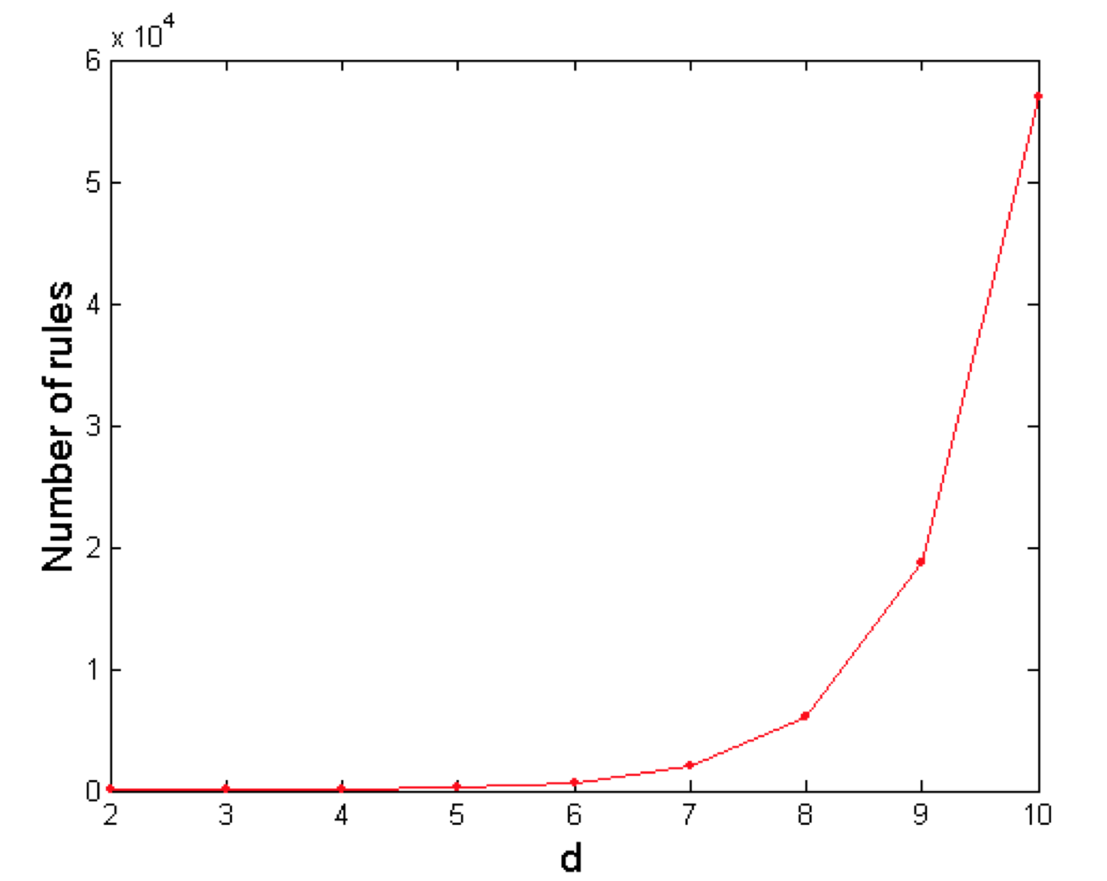
Complexity rises fast.
Brute-force approach is
computationally prohibitive!

Slide 22
Solutions

Slide 23




Solution Approaches
1) Rule Approach: Two Common Approaches, the de facto standards today, solve the exponential problem (there are many others):
Apriori (good)
FP Growth (better)
2) Data Processing - a mature scalable technology platform is required:
Spark – Batch Jobs: Data Collection, cleansing, ML Implementations.
Parallel in memory implementation of FP-Growth.
R – Interactive Exploration: Statistical tests, graphs, ML, can run on top of Spark.
WEKA – Exploration and run ML with ease.
Neo4J – Graph Data Base - Exploration/Runtime – Knowledge capture
Airflow – Orchestrate batch jobs.
Flintroc - bring up/down Spark EC2 clusters on the fly, reduce cost.
Notes:
Other Approaches: Mafia, Eclat, Predictive Apriori, Tertius, Hotspot.
SPARK The memory of multiple machines in a Spark cluster is used.

Slide 24
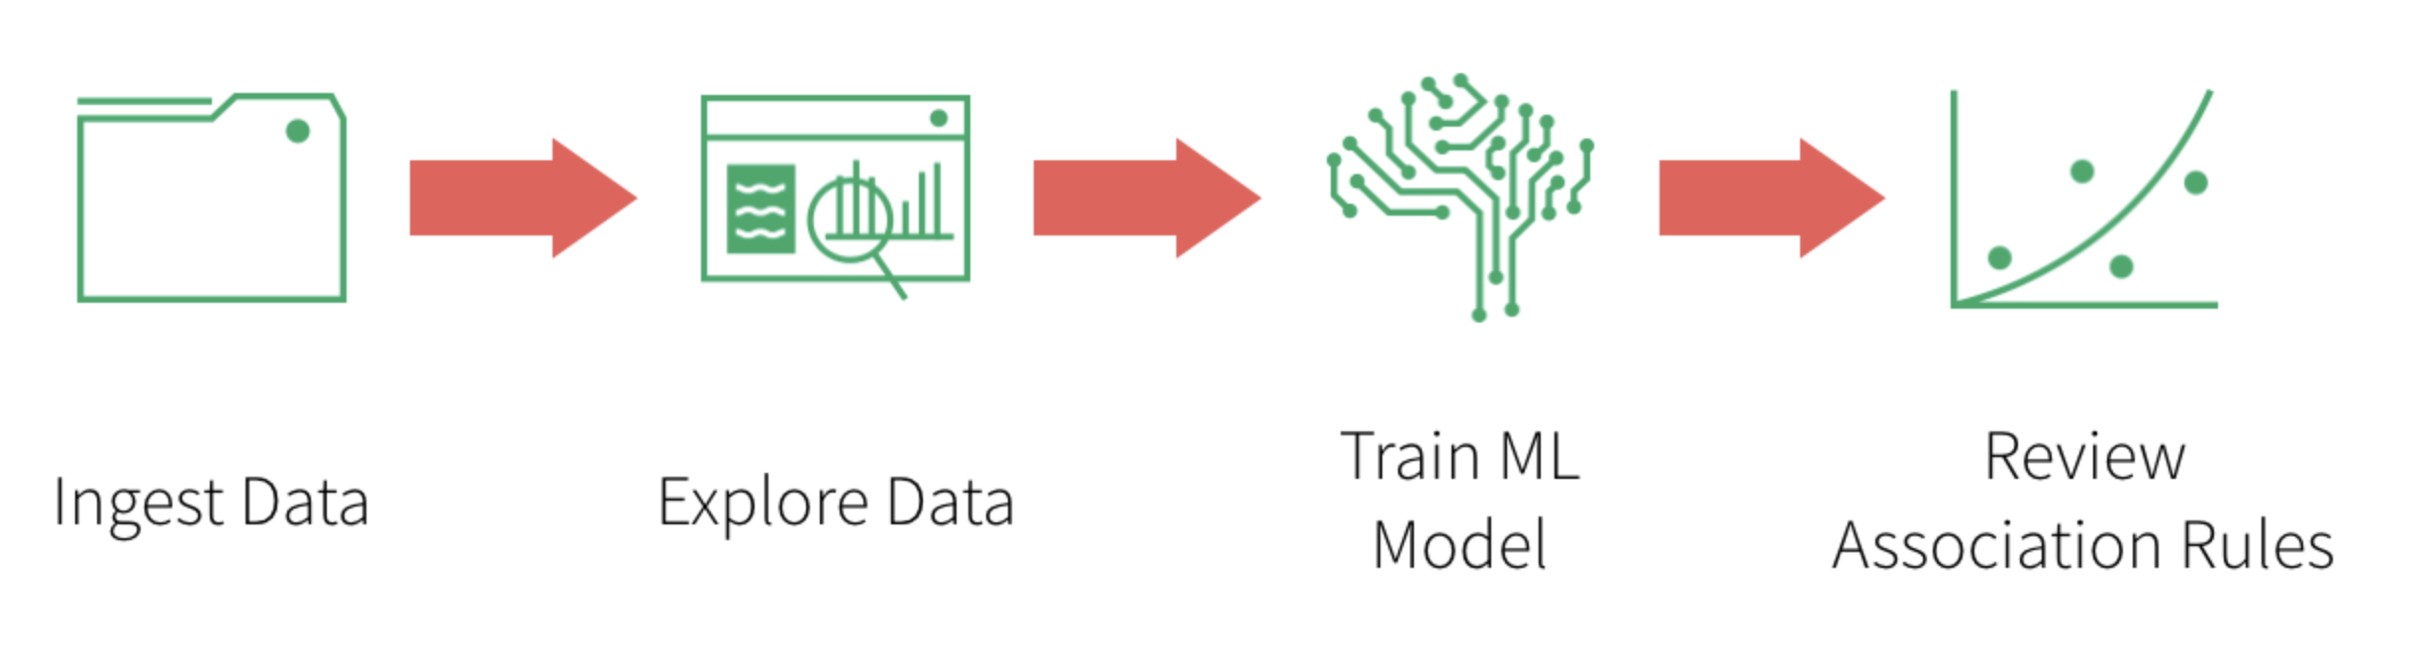

Process
It’s the final association rules that get deployed into production, to generate recommendations quickly, on the fly.

Slide 25
Apriori – solved the Combinatorial Explosion Issue
Brute Force Approach:
Itemset Generation: generate all item sets
Rule Generation: generate all rules and test with metrics.
Apriori Principle If an itemset is frequent, then all of its subsets must also be frequent
Apriori principle holds due to the following property of the support measure:
Support of an itemset never exceeds the support of its subsets
Using this we can prune the combinations down.
Apriori Approach:
Find all frequent item sets with support >= pre-determined min-support
List all Association Rules from frequent item-sets only.
Calculate Support and Confidence for all rules.
Prune rules that fail min-support and min-confidence thresholds.
Notes:
For All X and Y where X is a subset of Y implies support X more than Support Y.
Any subset of a frequent itemset must also be frequent. In other words, No superset of an infrequent itemset must be generated or tested

Slide 26
Set Enumeration
If this is infrequent
{}
1
We can ignore these
2
3
4
1,2
1,3
1,4
2,3
2,4
3,4
1,2,3
1,2,4
1,3,4
2,3,4
Still Issues:
The size of generated item sets can still be extremely large
Lots of time wasted on counting the support since we have to scan the itemset database over and over again
1,2,3,4

Slide 27
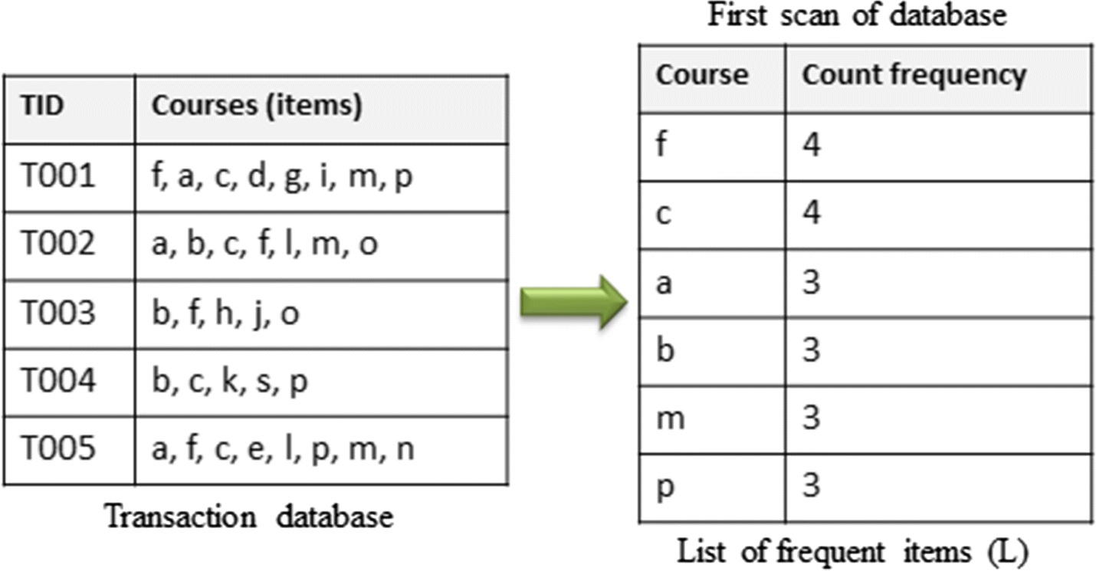
FP Growth ( Frequent Pattern Growth) – First Scan
FP Growth focuses on Frequent Patterns only. There is no Item set generation.
Anything less than threshold (minSupport) is not examined ( e.g. 2)
Example: Students do sets of courses; can we recommend future courses based on those done so far.
17 Courses = 131,072 combinations.
All others are less than 2.
Note: as with Apriori finding the right value of minSupport is important.
This order is important.
Notes:
Large-scale e-learning recommender system based on Spark and Hadoop
Karim Dahdouh,
Ahmed Dakkak,
Lahcen Oughdir &
Abdelali Ibriz

Slide 28
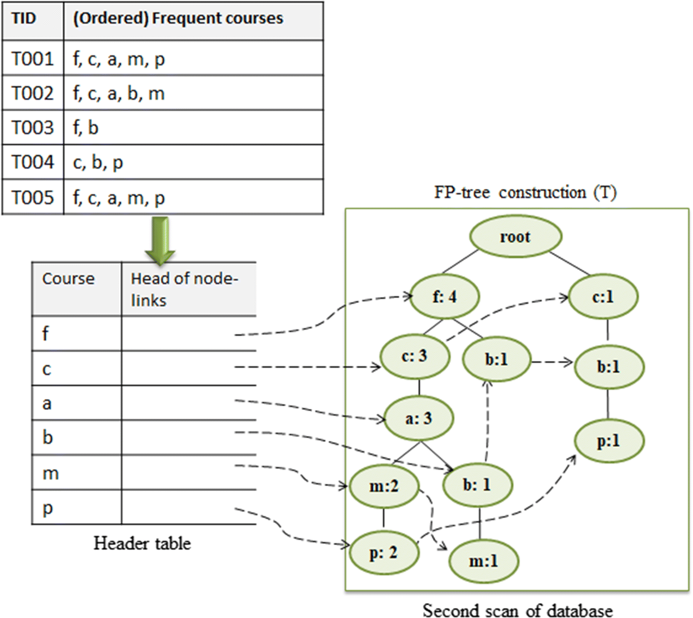
FP Growth the Second scan, then Grows an FP -Tree
Build the tree incrementally with each example
Take each example and using the items ordered by frequency (1st Scan) build a tree.
Not all combinations but just the examples.
Now generate rules with this.
Notes:
What happens next is described here: Han J, Pei J, Yin Y. Mining frequent patterns without candidate generation. In: International conference on manage-
ment of data, proceedings of the ACM SIGMOD; 2000. p. 1–12.

Slide 29
Setting Min Support is Critical – but not easy to do
https://www.youtube.com/watch?v=MbhldOiqgX0
Too high most items ignored, no rules
More Rules but ignores Items 3 & 4
Too many Rules no better than noise
Jobs take many hours, a global support does not work.
Set A
Set B
Notes:
https://www.youtube.com/watch?v=MbhldOiqgX0
Set B is different, as it may include clicks and A does not. Clicks are rare.
So you need to have different Min support for different data sub-sets, based on how rare they are.
The first step is to classify the Items into different sets.

Slide 30
Differential Min Support
Create different Min Support for different sets

Slide 31
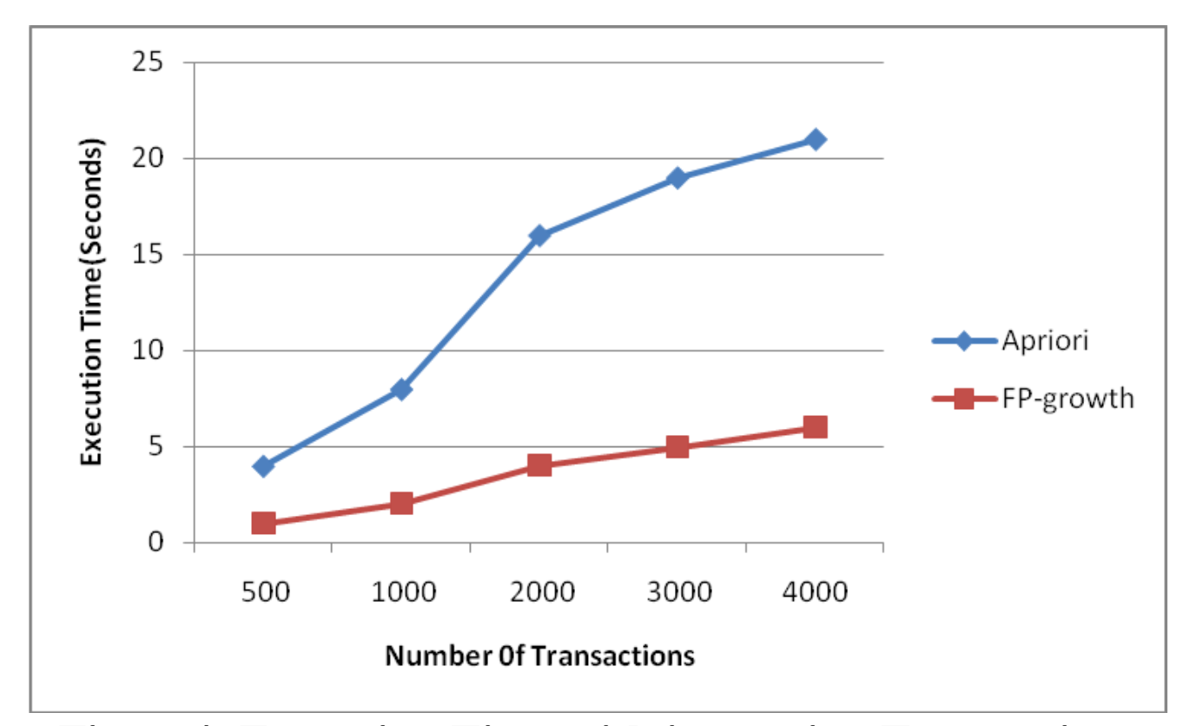
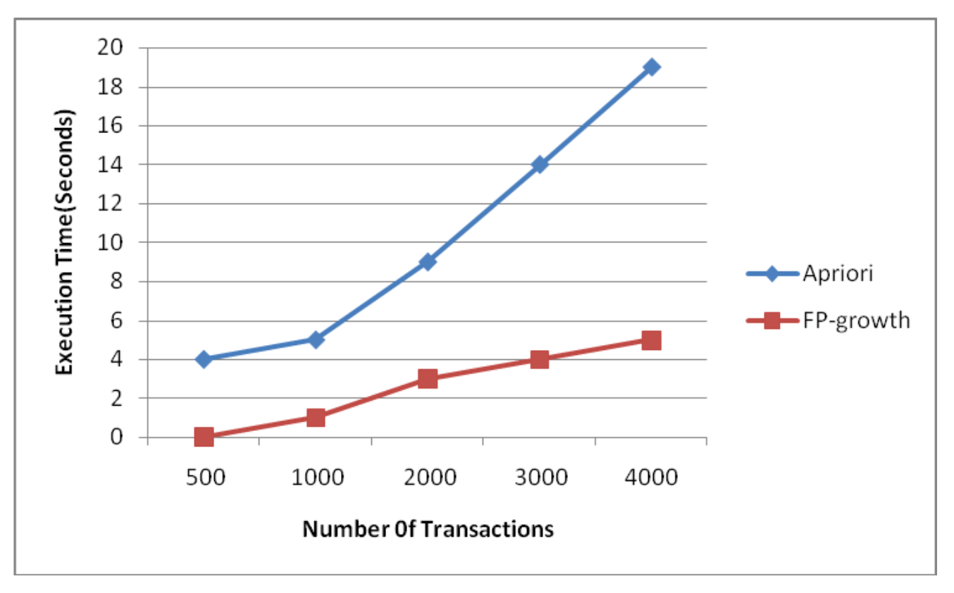
Performance Evaluation of Apriori and FP-Growth Algorithms
Support = 0.1
Support = 0.5
Notes:
/weka-3-8-5/data
4627 Transaction
217 Items
Performance Evaluation of Apriori and FP-Growth Algorithms
October 2013
International Journal of Computer Applications 79(10):34-37
DOI:10.5120/13779-1650
Authors:
M. S.Mythili
Mohamed Shanavas
Jamal Mohamed College

Slide 32
Weka and Spark Examples

Slide 33
Course Data File Example
5 examples of Student courses
a,b,c,d,e,f,g,h,i,j,k,l,m,n,o,p,s
t,?,t,t,?,t,t,?,t,?,?,?,t,?,?,t,?
t,t,t,?,?,t,?,?,?,?,?,t,t,?,t,?,?
?,t,?,?,?,t,?,t,?,t,?,?,?,?,t,?,?
?,t,t,?,?,?,?,?,?,?,t,?,?,?,?,t,t
t,?,t,?,t,t,?,?,?,?,?,t,t,t,?,t,?
f a c d g i m p
a b c f l m o
b f h j o
b c k s p
a f c e l p m n
course.arf file
Notes:
/Assoc Rules/course.arf

Slide 34
Apriori: The Resulting Rules and their Metrics
Results Weka: Apriori -N 10 -T 0 -C 0.9 -D 0.05 -U 1.0 -M 0.1 –S -1.0 –c -1
Do WEKA Example ->
N | If | Then | Confidence | Lift | Leverage | Conviction
1 | a | c | 1 | 1.25 | 0.12 | 0.6
2 | a | f | 1 | 1.25 | 0.12 | 0.6
3 | m | a | 1 | 1.67 | 0.24 | 1.2
4 | a | m | 1 | 1.67 | 0.24 | 1.2
5 | m | c | 1 | 1.25 | 0.12 | 0.6
6 | p | c | 1 | 1.25 | 0.12 | 0.6
7 | m | f | 1 | 1.25 | 0.12 | 0.6
8 | c, f | a | 1 | 1.67 | 0.24 | 1.2
9 | a, f | c | 1 | 1.25 | 0.12 | 0.6
10 | a, c | f | 1 | 1.25 | 0.12 | 0.6
Notes:
/Assoc Rules/course.arff

Slide 35
FPGrowth: The Resulting Rules and their Metrics
Results Weka: FPGrowth -P 2 -I -1 -N 10 -T 0 -C 0.9 -D 0.05 -U 1.0 -M 0.1
Do WEKA Example ->
N | If | Then | Confidence | Lift | Leverage | Conviction
1 | m | f | 1 | 1.25 | 0.12 | 0.6
2 | a | f | 1 | 1.25 | 0.12 | 0.6
3 | p | c | 1 | 1.25 | 0.12 | 0.6
4 | m | c | 1 | 1.25 | 0.12 | 0.6
5 | a | c | 1 | 1.25 | 0.12 | 0.6
6 | m | a | 1 | 1.67 | 0.24 | 1.2
7 | a | m | 1 | 1.67 | 0.24 | 1.2
8 | f, c | m | 1 | 1.67 | 0.24 | 1.2
8 | m | f,c | 1 | 1.67 | 0.24 | 1.2
10 | f, m | c | 1 | 1.25 | 0.12 | 0.6
Notes:
Assoc Rules/MLFPGrowthFiles/Data/parts

Slide 36
Back to Parts Example – Applying FPGrowth
We speculated two rules:
Rule 1: Part A ➔ Part B
Rule 2: Part A ➔ Part C
Do Spark Example ->
Rule | If | Then | Confidence | Lift | Support
1 | a | b | 0.71 | 0.89 | 0.105
2 | c | a | 1.0 | 6.78 | 0.042
The high confidence rule 1 is not good, as Lift states that we should not recommend B with A.
Rule 2 has high lift, but is reversed, buying Part C recommends buying Part A.
The Dilemma of product recommendations ( why you need exploration tools ):
We can find any number of rules with perfectly high confidence but support of only one or very few records.
On the other hand, we can construct very general rules with large support but low confidence.
Notes:
The example Illustrates

Slide 37
Exploration Tools

Slide 38
Basic ‘Association’ Questions that can be Explored with R
Questions to ask before starting with fancy techniques:
Average number of orders per customer;
Change in average number of orders per customer over time;
Number and diversity of items (e.g. not all diapers and beer);
Average number of unique items per order;
Change in average number of unique items per order over time;
Proportion of customers and average purchase size of customers who purchase the most popular products;
Proportion of customers and average purchase size of customers who purchase the least popular products;
Average order size;
Changes in average order size over time;
Average order size by important dimensions, such as geography, method of payment, time of year, and so on;
Can order items be segmented by location, catalogues, product types ?
Can a product hierarchy be applied, general to specific ?

Slide 39
Actions from Products that are frequently bought together
Actions:
Real time on-line ordering recommendations, while shopping.
In a store, both X and Y can be placed on the same shelf, so that buyers of one item would be prompted to buy the other.
Promotional discounts could be applied to just one out of the two items.
Targeted Marketing - Advertisements on X could be targeted at buyers who purchase Y.
X and Y could be combined into a new product, such as having Y in flavours of X.

Slide 40
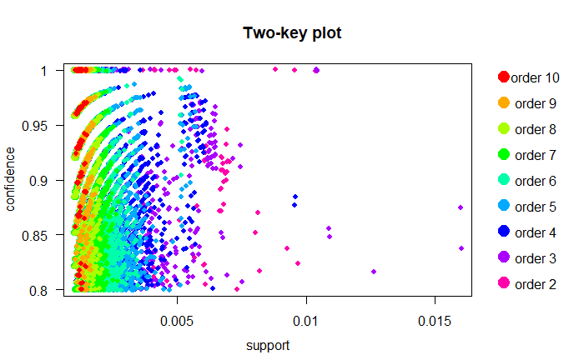
Using R to Visually Explore Rules by order, support and confidence
Order = Length of Rule

Slide 41
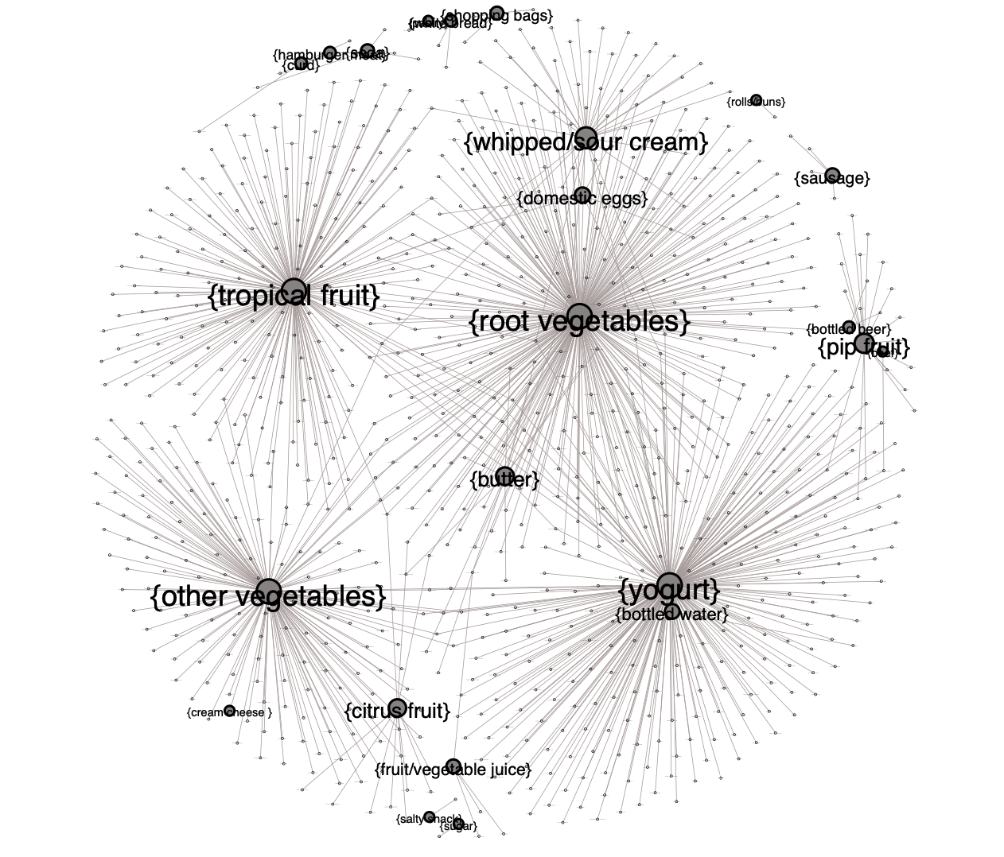
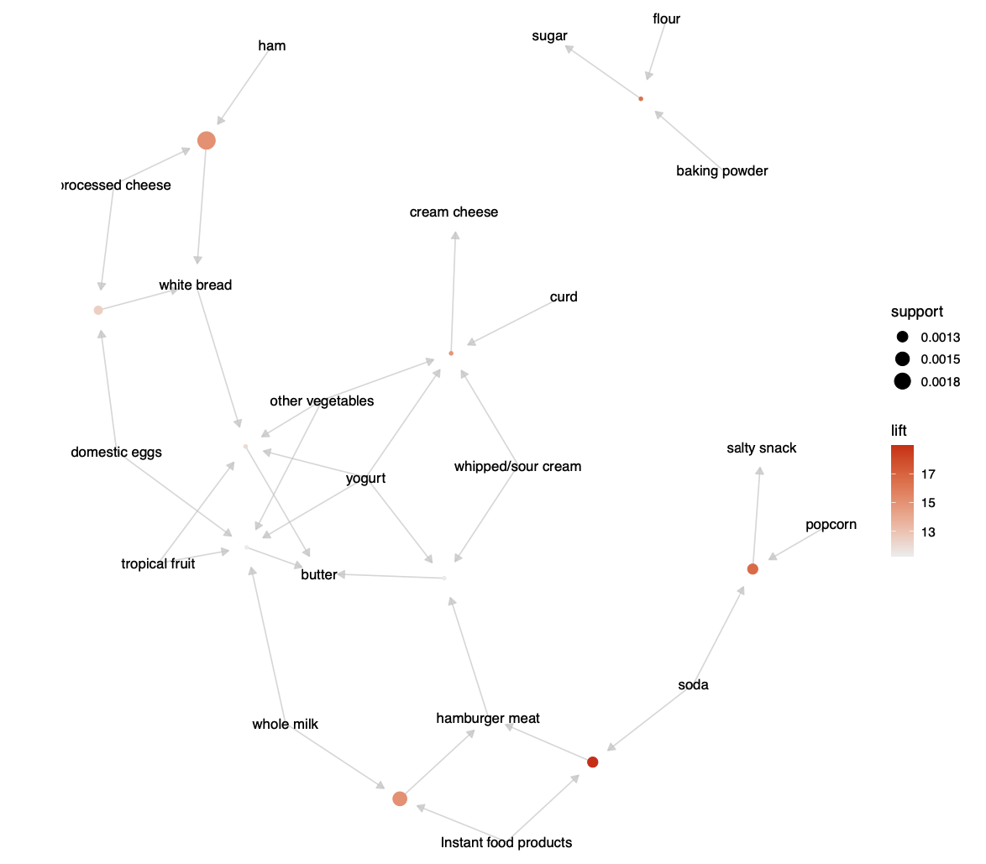
Using R to Explore Rule Item relationships, support and lift

Slide 42
Summary

Slide 43
Follow on Issues
Caveats & Valid Data Mining / Testing Process:
We only have one set of historical data to do all this with. We have to use this forever to refine and improve the results. If we use this in the wrong way then likely future usage can be impacted.
Need a valid sampling testing strategy – need to design valid experiments.
Uneven Samples – effects from frequent/infrequent items - roll products up a part hierarchy.
Even though we see differences, are the results statistically significant; better than chance ?
It is quite possible we just don’t have enough data, or variety of orders, to make valid recommendations.
No Power (numbers) or many Uninteresting Rules
Experiments for Hyperparameter Tuning – see Weka has 17 parameters for Apriori & FP Growth, more art than science. Spark, R and Weka have tools to help find the optimal values (e.g. Weka Experimenter)
No Free Lunch Theorem: There is no one technique that works for all data.
Outcomes: Actual Change in Customer behaviour:
Metrics: data will be collected on its performance; precision & conversions over time;
Precision over time: does it change over time, e.g. seasons, across years as models mature ?
Conversions: do the recommendations get converted into orders or are they ignored, measure the usage;
Notes:
Infrequent items may be interesting but are dropped by support.

Slide 44
Follow on Issues
Incremental Improvement
When do we need to rebuild the rules ?
We can explore approaches to incrementally add new rules, with new data, rather than a big rebuild.
Data Issues
Catalogues – Models – VINs. Part Numbers Vs PNCs (Part Name Codes), Supersessions.
Robust Vehicles like TMH Fork Lifts may have very specific parts replacement types.
Generalise up to a type of part type, e.g. break-pad, air-filter, tie-rod; maybe across models or brands.
Many reasons for an Orders: Re-Stock Orders, Multiple vehicles on one order, accident (multiple sections), scheduled service ( parts across sections), breakdowns (one-section).
Further analysis to get ‘Quality’ rules - remove effects of time, dealerships, models, etc
Use of Knowledge - Futures:
Vehicles are highly structured: Types, Connections, Groupings, Operations
We ‘know’ what parts are connect to what; what parts are part of a whole;
We can understand causality, Part A broken -> Part B broken;
We know what operations (SSM) require what parts. Is this knowledge better than past associations ?
We could learn what parts are replaced together in a section, and capture this knowledge in a Graph.
Notes:
Association Rules are a first step: there is then Sequence mining, and then Process Mining.
Vin specific parts can’t be used, there just won’t be enough data

Slide 45
Product Recommendations as a Product
Parts recommendation is a full EPC Feature that can be used across all Franchises, not just TMH.
Product recommendations is a technology solution we can use across many of our products.
Recommendations are a new data asset that can be sold as a product. Other companies can use the rules (data) generated to add value to their sales.
Notes:
Infrequent items may be interesting but are dropped by support.

Slide 46
The End ”The aim of statistics is so you don't make a fool of yourself with data “

Slide 47
Who am I – to talk about this
First degree in Psychology and Statistics:
Research, design and statistical analysis of scientific experiments.
Neuroscience and Learning
First jobs as biomedical statistician, e.g. predicting child learning disorders.
Taught Doctors how to do experimental research at Garvan Institute of Medical Research.
Master’s degree in AI and Machine Learning.
Worked with 2 world famous AI Researchers at Sydney Uni, Touring Institute, and UNSW.
Built GARVAN-ES1 – one of worlds first production Medical AI systems, 1983 at Garvan
Published over 30 Articles in AI and Machine Learning in refereed journals.
Worked for 20 years full time applying AI, Machine Learning, Data Mining in Medicine, telecommunications, Manufacturing, Electronics, Marketing, Finance, Stock Market Trading.
Consultant in AI as Innovation for many companies.
Post Graduate lecturer, and Phd supervisor, in AI at various Universities.
Developed numerous data mining products - Data Mining/AI product manager.
Continually keeping abreast of AI, Machine Learning, Natural Language Understanding and DataMining trends and technologies.
Still building new AI tools. Interested in Symbolic, Process and Interactive Machine Learning and Hidden Context.

Slide 48
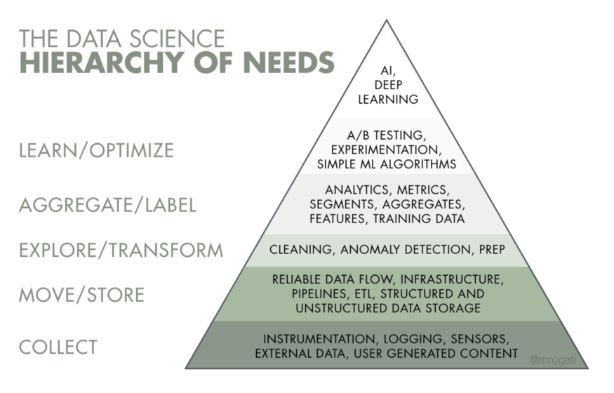
Data Science

Slide 49
Removing Redundant Rules
A more specific rule, that has another condition, with same or lower lift is redundant.
It can be pruned.
Bread - > Butter Lift 1.5
Bread, Milk -> Butter Lift 1.5
Bread, Jam -> Butter Lift 1.1
Bread, Coffee -> Butter Lift 2.4
We can safely remove Rule 2 & 3.

Slide 50
Metrics

Slide 51
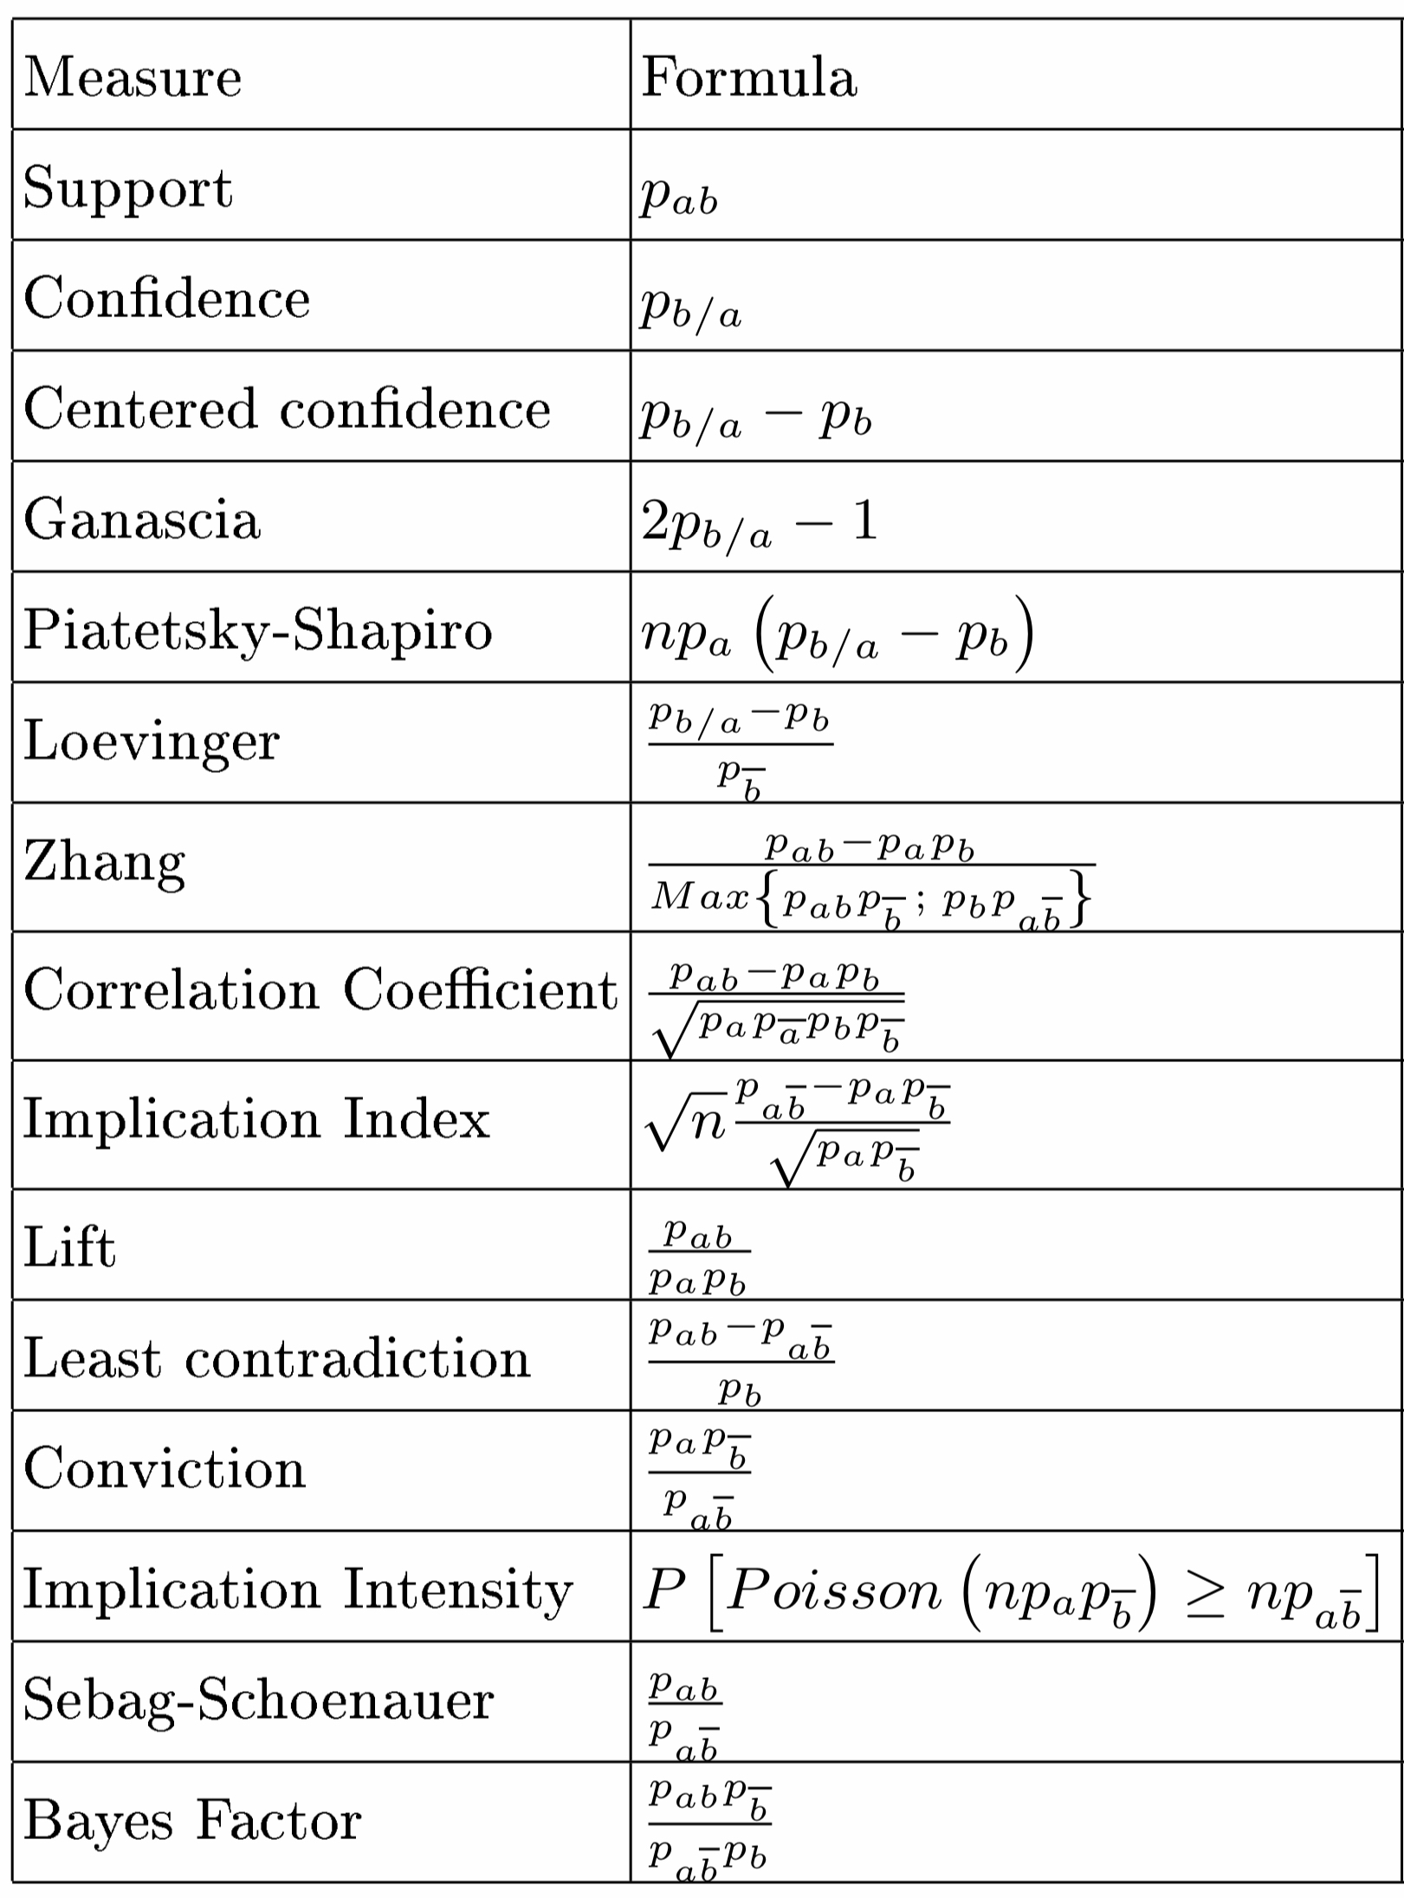
Many Metrics, Interestingness
Others
ECR - Examples and counter-examples rate
EII - Entropic intensity of implication
IG - Information gain
IntImp – Intensity of Implication
Kappa - Kappa coefficient
Lap - Laplace
PDI - probabilistic discriminant index
Notes:
Association Rule Interestingness Measures: Experimental and Theoretical Studies
January 2007
In book: Quality Measures in Data Mining (pp.51-76)

Slide 52
Formulas

Slide 53
Support, Confidence
sup(X -> Y) = sup(Y -> X) = P(X and Y)
Support is a so-called frequency constraint. Its main feature is that it possesses the property of down-ward closure which means that all subsets of a frequent set (support > min. support threshold) are also frequent. This property (actually, the fact that no super set of a infrequent set can be frequent) is used to prune the search space (usually a tree of item sets with increasing size) in level-wise algorithms (e.g., the APRIORI algorithm). The disadvantage of support is the rare item problem. Items that occur very infrequently in the data set are pruned although they would still produce interesting and potentially valuable rules.
conf(X -> Y) = P(Y | X) = P(X and Y)/P(X) = sup(X -> Y)/sup(X)
Confidence is not down-ward closed and was developed together with support (the so-called support-confidence framework). While support is used to prune the search space and only leave potentially interesting rules, confidence is used in a second step to filter rules that exceed a min. confidence threshold. A problem with confidence is that it is sensitive to the frequency of the consequent (Y) in the data set. Caused by the way confidence is calculated, Ys with higher support will automatically produce higher confidence values even if they exists no association between the items.
https://michael.hahsler.net/research/recommender/associationrules.html

Slide 54
Lift, Confidence and Leverage
lift(X -> Y) = lift(Y -> X) = P(X and Y)/(P(X)P(Y)) = conf(X -> Y)/sup(Y) = conf(Y -> X)/sup(X)
Lift measures how many times more often X and Y occur together than expected if they where statistically independent. Lift is not down-ward closed and does not suffer from the rare item problem.
However, it cannot distinguish direction of rule A->B, is same as B->A
leverage(X -> Y) = P(X and Y) - (P(X)P(Y))
Leverage measures the difference of X and Y appearing together in the data set and what would be expected if X and Y where statistically dependent. The rational in a sales setting is to find out how many more units (items X and Y together) are sold than expected from the independent sells. Leverage can suffer from the rare item problem.
conviction(X -> Y) = P(X)P(not Y)/P(X and not Y)=
(1-sup(Y))/(1-conf(X -> Y))
Conviction compares the probability that X appears without Y if they were dependent with the actual frequency of the appearance of X without Y. In that respect it is similar to lift, however, it contrast to lift it is a directed measure. Furthermore, conviction is monotone in confidence and lift.

